Slide 1
Integrate Graph connector content into various M365 experiences
Mounika Narayanan

Slide 2
Agenda
Intro to Microsoft Search + Graph connectors
Demo
Graph connector anatomy
Building your custom connector
Notes:
Our session has 3 segments. First, I will introduce you to Graph connectors and Microsoft Search, then Mounika will show you a custom connector that Microsoft IT has built, and walk you through a number of experiences that its content is integrated into. In the 3rd segment, Rajdeep will walk you through some code and teach you the basics of how you can build your own connector. Whether you are an IT administrator or a developer, there will be something for you.

Slide 3

Organizational data is growing exponentially
Data live in silos
20% to 30% time lost searching for information
Modern workers need to find and discover info quickly
Notes:
Organizations today are generating data at a faster rate than ever, and the pandemic has worsened this trend in the last couple of years. Making matters worse, data are often created in silos, making them more difficult to find and discover.
Multiple analyst reports have estimated that information workers spend anywhere between 20 to 30% of their time just searching for the information they need to do their jobs. Additional productivity is lost because people need to duplicate work when they couldn't find the information they were looking for.
Modern information workers are often frustrated by this, and they increasingly expect to be able to find the right information quickly across their organizations.

Slide 4













AI-powered, modern search for your workplace
Included with Microsoft 365
Relevant and personalized results
Data is always secured
Search from any device, anywhere
Microsoft Search
Notes:
But for Microsoft customers, there is good news. Microsoft Search, which is our AI-powered, modern search engine designed for organizations, is already included with your Microsoft 365 subscription.
It’s built on top of the Microsoft Graph and it takes into account user activities and relationship with the data to provide the most relevant and personalized search results.
Being an enterprise search product, security is critical. Microsoft Search supports security trimming to ensure only users who are supposed to see the data can see the search results.
And Microsoft Search meets you where you are by being available on multiple form factors, and multiple endpoints including Bing, SharePoint, Office.com and Windows Search Box.

Slide 5

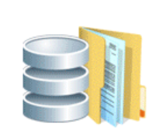


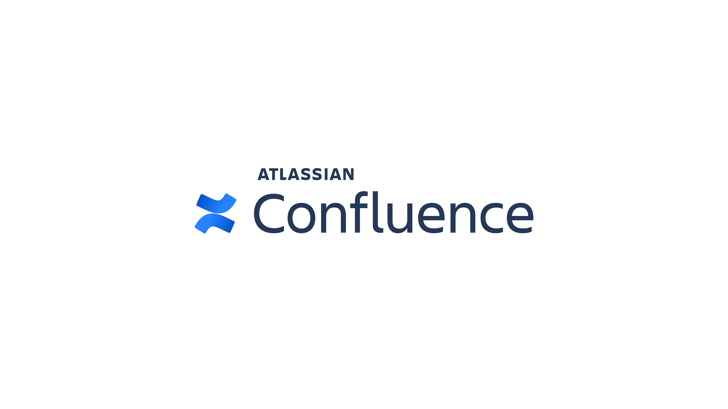


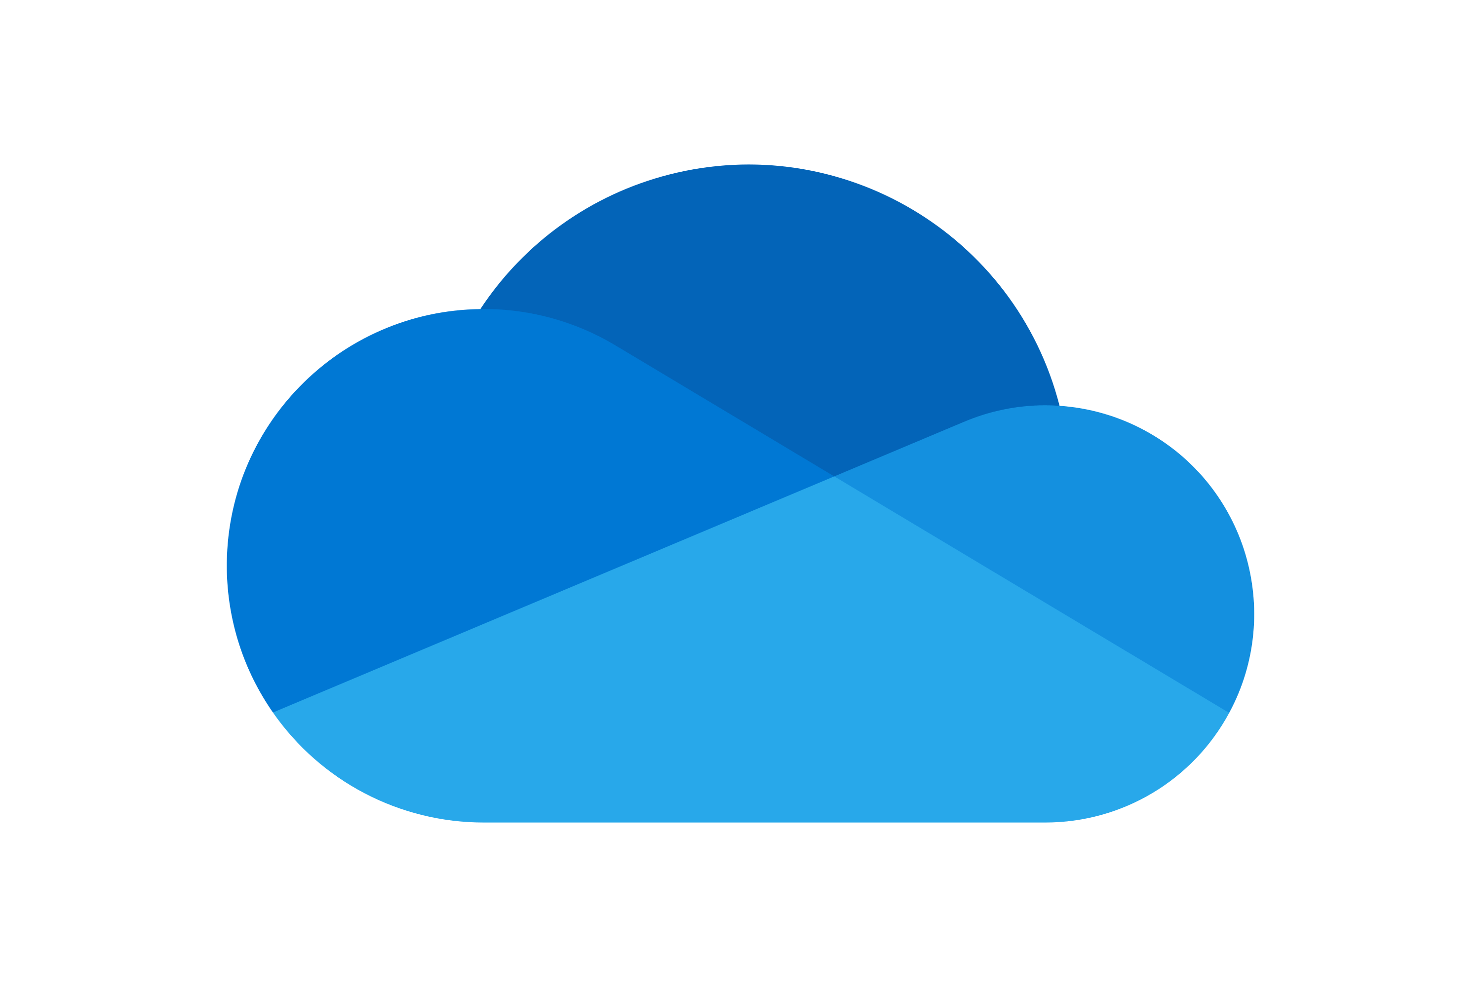





Graph connectors connect your data sources Microsoft Search
Over 130 data sources supported
APIs enable you to develop custom connectors
Microsoft Search
Notes:
And of course, with any enterprise search engine, connectors are important.
Microsoft Search will already index all your SharePoint online and OneDrive for work content, with zero setup.
But to increase your search completeness and coverage, you can use Graph connectors to connect to your SaaS data sources, your on-prem file shares, databases or content management systems, and any other custom line of business data sources, so Microsoft Search can index all of them and make the available for search.
Between Microsoft and our partners, there are over 130 connectors, and you can find them at the Graph connectors Gallery.
You can also use the Graph connectors API to develop your own connector. Whether you are implementing a custom connector for your organization, or if you are a SaaS vendor, wanting to make your product’s content searchable in Microsoft Search, these are the right APIs for you to use.

Slide 6
Connected data becomes part of Microsoft Graph
Connected data can participate in multiple Microsoft 365 experiences
Search
Context IQ
Recommendations
Viva Topics
E-Discovery
Notes:
But the story gets better. When data is connected to through our platform, it’s really indexed into the Microsoft Graph, which is the underlying data fabric that powers many Microsoft 365 experiences.
What that means, is that the connected data transcends the traditional search experience of a search box and 10 blue links, and it can participate in other experiences like Context IQ, content recommendations, Viva Topics, E-Discovery and more.
So with this platform, you are really connecting your data to Microsoft 365 and not just Microsoft Search.
Now let me pass it onto Mounika to demo what some of these experiences look like with connector data.

Slide 7
Demo Connector content integration with various M365 experiences

Slide 8
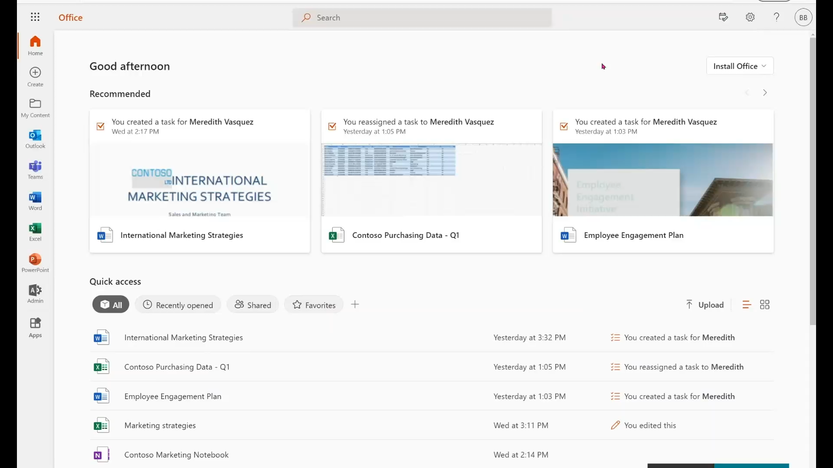

Slide 9



Graph Connector Anatomy
Create connection
Define connection object
Update config for experiences
Provide additional optional connection configuration
Create and register schema
Create a new schema object with properties and their attributes, labels, and aliases
Register the schema before adding items to the connection
Index items with their ACLs
Create/update/delete items
Create/update/delete external groups and group members
Notes:
You can create a custom connector by implementing 3 key components:
Create connection: Here you will need to do things like defining the connection object, updating config for enabling experiences that will leverage your connector and provide additional configuration required for creating a connection to Microsoft Graph.
Create and register schema: Here you will need to gather schema information of the source data define the data source schema for the connection along with their properties. You need to register the schema to be able to add items to the connection.
Index items: In this step you’ll be indexing items with their corresponding access control lists. We allow you to specify ACLs on a per item basis. You can create/update/delete external groups and their members to define these ACLs. Finally, you will call the Graph API to create, update or delete on an item by item basis.

Slide 10
Create Connection
1
POST https://graph.microsoft.com/beta/external/connections
Content-type: application/json
{
"id": “FigmaConnector",
"name": “Figma Projects and Files Connector",
"description": "Connection to Figma application”,
"enabledContentExperiences": "search, contextualInsertion”,
"activitySettings":
{
"urlToItemResolvers": [
{
"@odata.type": "microsoft.graph.externalConnectors.itemIdResolver",
"priority": 1,
"urlMatchInfo": {
"baseUrls": [
https://figma.com, https://www.figma.com
],
"urlPattern": "/file/(?<fileid>[a-zA-Z0-9]+)"
},
"itemId": "{fileid}”
}
}
Notes:
First you will need to create a connection. This is a very simple call, and I will highlight the graph endpoint for you here. You just pass in an ID, name and description. The ID is something you will need in subsequent calls, and the name and description are the strings that will show up in the Connectors Admin UX.

Slide 11
Create Schema
2
POST https://graph.microsoft.com/beta/external/connections/FigmaConnector/schema
Content-type: application/json
{
"baseType": "microsoft.graph.externalItem",
"properties": [
{
"name": “figma_title",
"type": "String",
"isSearchable": "true",
"isRetrievable": "true",
“labels": ["Title"]]
},
{
"name": “figma_author",
"type": "String",
"isQueryable": "true",
"isRetrievable": "true"
"isRefinable": "true"
},
...
]
}
Labels:
Title
LastModifiedBy
LastModifiedDate
URL
FileName
FileExtension
Notes:
Next you need to create a schema for the connection that you just created. Note that FigmaConnector here is the connection ID that was passed in in the earlier call.
In the body of this call, you define the schema, which is the list of properties that each item ingested later will have.
For each property, you define the property’s name and data type, and also a set of optional behaviors for that property – whether it is searchable, retrievable, queryable or refinable. If you are not familiar with what these attributes mean, you can learn more about them in our documentation.
We have recently added support for something called “labels”. Labels allow you to pass in a collection of well-known strings to tell Microsoft Graph what this property semantically means. In this example, even though the property is called figma_title, you are saying that semantically, it means title, so the Graph will know how to use this property in things like relevance or default display templates. There are several other well-known strings you can use for labels, and we will likely be adding more in the future.

Slide 12
Create externalItem
3
PUT https://graph.microsoft.com/beta/external/connections/contosotickets/items/TSP228082938
Content-type: application/json
{
"@odata.type": "microsoft.graph.externalItem",
"acl": [
{
"type": "user",
"value": "49103559-feac-4575-8b94-254814dfca72",
"accessType": "deny",
"identitySource": "Azure Active Directory"
}
],
"properties": {
"title": “Branding Case Study",
“author": “bobthebuilder@wearebuilders999.onmicrosoft.com"
},
"content": {
"value": "<h1>Branding Case Study</h1><p>In CY22 H2 we...</p>",
"type": "html"
},
}
Notes:
Now that you have created the connection and the connection’s schema, it’s time for you to start adding items into this connection. To do that, you do a PUT on this endpoint. Note that, you can use any ID that you want to, and this quite often could come from the source data. In the body of the create externalItem call, there are 3 sections. The ACL section allows you to specify your access control lists for this item to ensure only the groups and users you want will be able to see this item anywhere in the Microsoft 365 experiences. In the next section, you specify the properties of this item and this should adhere to the schema that you defined for this connection. The last section is content, which allows you to specify the body of your item in either html or text format. Anything you put here will automatically be added to the full text index.
In summary, create connection, create schema and create externalItem are the 3 key API calls you need to know about to get started creating a connector.

Slide 13
Add Activities
4
POST https://graph.microsoft.com/beta/external/connections/contosotickets/items/TSP228082938/addActivities
Content-type: application/json
{
"activities": [ {
"@odata.type": "#microsoft.graph.externalConnectors.externalActivity", "type": "created", "startDateTime": "2022-04-11T16:25:34.3202005Z", "performedBy": { "id": "18948b93-d3ed-4307-9981-10fc36a08a52",
"type": “user” } }, {
"@odata.type": "#microsoft.graph.externalConnectors.externalActivity", "type": "modified", "startDateTime": "2021-04-13T06:37:12.6402005Z", "performedBy": { "id": "b5f15ff8-29da-4301-b8ed-1c4585879c7c",
"type": “user” } } ]
}
Notes:
We are also adding the capability to add activities on an externalItem to light up the experiences we just showcased. To do that, you do a POST on this endpoint. Note that, you need to use the ID of the externalItem for which you want to add activities, define the type of activity, the time of occurrence of the activity and the actor of the activity. You can see the AAD ID of the user being added to identify who performed the activity.

Slide 14













GRAPH CONNECTORS ROADMAP
CY22 H1
CY22 H2
Connectors
Azure DevOps
Jira cloud
Jira Server
CSV
ServiceNow Catalog
Confluence cloud
Confluence Server
ServiceNow Tickets
Interleaved search results for connector content
Windows Search Box support
Search Features
Higher connection capacity (up to 5M items)
Teams search support
@
Context IQ support
Intelligent Discovery support
Other Experiences
Viva Topics support
E-Discovery support
Graph connectors SDK

Slide 15



Summary
Microsoft Search + Graph connectors
Microsoft 365 Experiences
+
Graph connectors
Building your own Graph connector
Notes:
Thank you Mounika and Rajdeep.
So in summary, we have talked about how the combination of Microsoft Search and Graph connectors can deliver a world-class intelligent search experience for your workplace.
We walked through some of the innovative experiences in Microsoft 365 that your connector content can deeply integrate into.
And we also went over the nuts and bolts of how you can go about building your own customer connector.

Slide 16
Resources
1
Admin documentation aka.ms/graphconnectors
2
Developer documentation aka.ms/graphconnectorsapi
3
Connectors Gallery aka.ms/graphconnectorsgallery
Notes:
Here are some resources that should be useful to you, if you decide to explore Graph connectors further.
You can visit our Admin documentation site to learn about how to setup and configure connectors.
You can visit our developer documentation site to access our getting started guide, sample code, API reference docs, and Postman collection.
Finally, you will find all the Graph connectors available in our ecosystem from the Connectors Gallery.

Slide 17
Questions?
Notes:
Here are some resources that should be useful to you, if you decide to explore Graph connectors further.
You can visit our Admin documentation site to learn about how to setup and configure connectors.
You can visit our developer documentation site to access our getting started guide, sample code, API reference docs, and Postman collection.
Finally, you will find all the Graph connectors available in our ecosystem from the Connectors Gallery.

Slide 18
Thank you! ☺
Notes:
Here are some resources that should be useful to you, if you decide to explore Graph connectors further.
You can visit our Admin documentation site to learn about how to setup and configure connectors.
You can visit our developer documentation site to access our getting started guide, sample code, API reference docs, and Postman collection.
Finally, you will find all the Graph connectors available in our ecosystem from the Connectors Gallery.

